Slide 1
Mental Health Mood & Wellness Journal with Analytics
CAPSTONE PROJECT
Presented By:
Student Name- Sheetal Gehlawat
College Name- Manav Rachna International Institute of Research and Studies
Department – Nutrition and Dietetics
4. AICTE ID- STU6a5f261688c541784620566

Slide 2
OUTLINE
Problem Statement
Proposed System/Solution
System Development Approach
Algorithm & Deployment
Result
Conclusion
Future Scope
References

Slide 3
Problem Statement
Mental health issues often go undetected because individuals have no easy way to track mood patterns over time or share meaningful insights with a therapist.

Slide 4
Proposed Solution
The proposed system aims to address the challenge of tracking daily mental wellness by providing a private journaling application that records mood, stress, sleep, and personal reflections. The system uses local data analytics and optional AI-assisted insights to help users understand their wellness patterns over time. The solution consists of the following components:
Daily Wellness Data Collection:
Record daily mood and stress levels using a 1–10 scale.
Record hours of sleep and sleep quality along with optional personal journal notes.
Allow users to review and manage their previous wellness entries.
Data Storage & Management:
Store journal entries locally on the user's device in a CSV file.
Provide options to filter, review, export, and delete journal entries.

Slide 5
Keep data private by default without automatic cloud synchronization or third-party sharing.
Wellness Analytics:
Calculate overall averages for mood, stress, sleep, and sleep quality.
Provide weekly and monthly wellness summaries to help identify changes over time.
Use rule-based thresholds to flag potentially concerning wellness patterns.
AI-Assisted Wellness Insights:
Use Google Gemini 3.6 Flash to generate reflective wellness summaries.
Provide AI-generated trend summaries, journal-note themes, and weekly wellness reflections.
AI insights are generated only when explicitly requested by the user.

Slide 6
Privacy & Consent:
Keep therapist sharing optional and disabled by default.
Allow users to provide explicit consent before generating a therapist-shareable summary.
Clearly inform users when data is sent to the Gemini API for AI-assisted features.
Result:
A private wellness journaling system that enables users to record daily well-being, review historical data, visualize wellness patterns, and obtain optional AI-assisted reflections while maintaining user control over their data.

Slide 7
System Approach
The system approach outlines the overall strategy and methodology used to develop and implement the Mental Health Mood & Wellness Journal. The application was developed using IBM Bob Agent and Visual Studio Code, with a focus on local data storage, wellness analytics, rule-based pattern detection, and optional AI-assisted reflections.
System Requirements:
Development Tools: IBM Bob Agent and Visual Studio Code
Programming Language: Python
Application Framework: Streamlit
Data Storage: Local CSV file
AI Integration: Google Gemini 3.6 Flash API
Client: Web-based application running locally

Slide 8
Libraries/Technologies Required:
Streamlit – Used to create the interactive web application interface.
Pandas – Used for storing, processing, filtering, and analysing journal data.
Google Gemini API – Used to generate optional AI-assisted wellness reflections.
Python Standard Libraries – Used for application logic, data handling, and supporting functionality.

Slide 9
Algorithm & Deployment
Algorithm Selection:
The application uses rule-based wellness pattern detection to identify potentially concerning patterns in mood, stress, and sleep data. Optional AI-assisted reflections are generated using Google Gemini 3.6 Flash.
Data Input:
Daily mood score (1–10)
Stress level (1–10)
Hours of sleep
Sleep quality (1–10)
Optional personal journal notes
Historical journal entries for trend and pattern analysis

Slide 10
Processing & Pattern Detection:
Journal data is processed locally to calculate overall, weekly, and monthly wellness averages.
The system analyses recent entries using predefined rule-based thresholds.
Potentially concerning patterns are flagged for user awareness.
The system does not provide medical diagnoses or clinical assessments.
AI Processing:
When the user explicitly requests an AI insight, relevant wellness data is sent to the Google Gemini 3.6 Flash API.
Gemini generates wellness trend summaries, journal-note themes, and weekly reflections.
AI-generated content is presented only as general wellness reflection, not professional medical advice.

Slide 11
Deployment:
The application is developed using IBM Bob Agent and Visual Studio Code.
It is implemented as a Streamlit web application.
The application currently runs locally on the user's computer.
Journal data is stored locally in a CSV file, while AI features require an explicit user request.

Slide 12
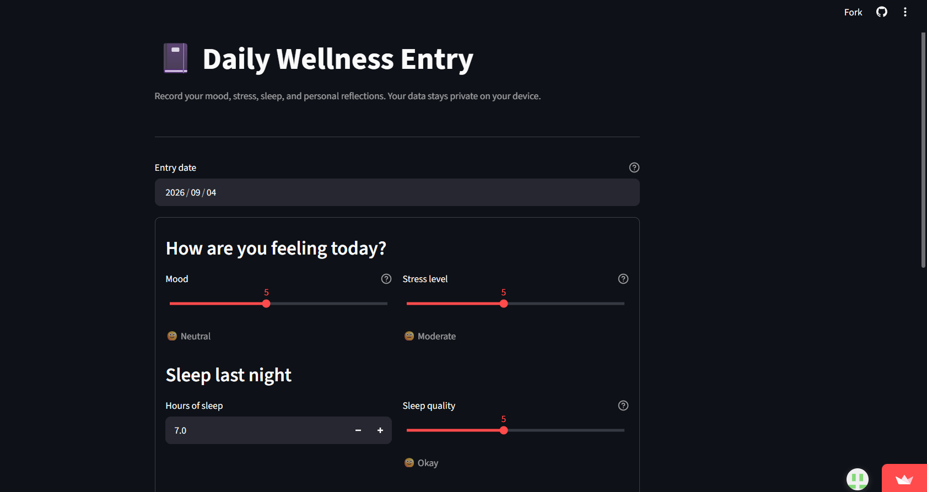
Result
A private wellness journaling system that enables users to record daily well-being, review historical data, visualize wellness patterns, and obtain optional AI-assisted reflections while maintaining user control over their data.

Slide 13
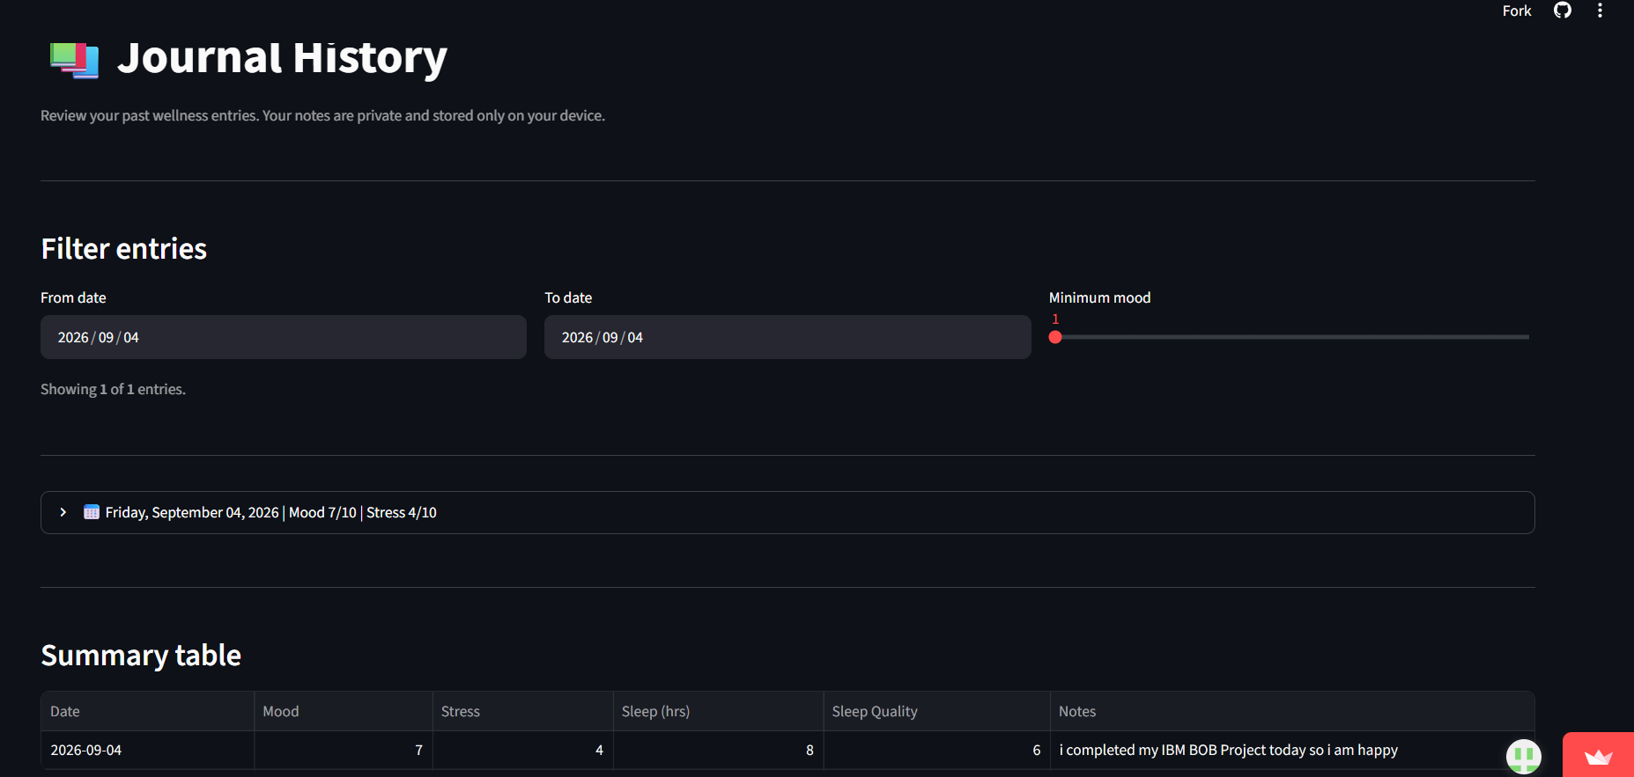

Slide 14
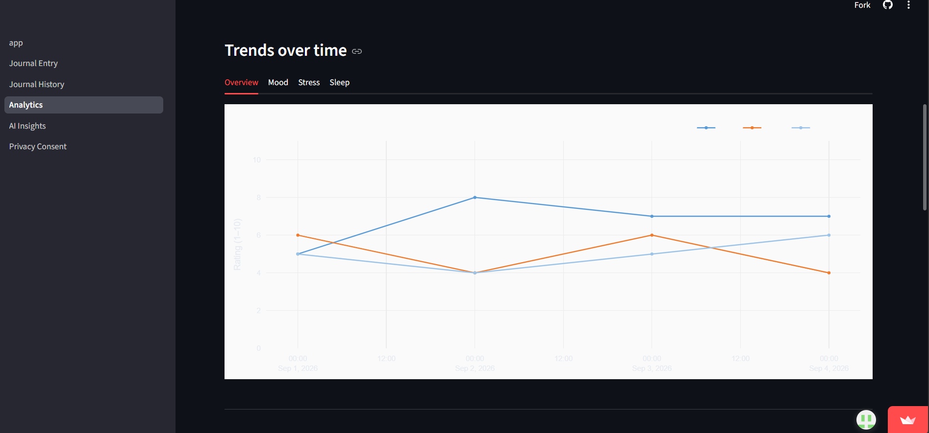

Slide 15
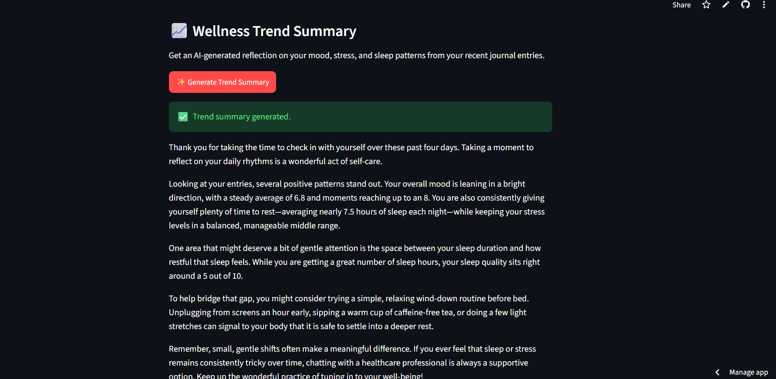

Slide 16
Conclusion
The Mental Health Mood & Wellness Journal with Analytics provides a private and user-friendly platform for tracking daily well-being.
The system enables users to record and review mood, stress, sleep, and personal reflections in one place.
Local analytics help users understand their wellness trends and patterns over time.
Rule-based pattern detection provides simple wellness indicators without presenting them as medical diagnoses.
Optional AI-assisted reflections using Google Gemini 3.6 Flash provide additional support for personal wellness reflection.
Overall, the project demonstrates how AI and data analytics can be combined with a privacy-focused journaling system to support personal mental wellness tracking and reflection.

Slide 17
Future scope
The Mental Health Mood & Wellness Journal can be further enhanced with the following developments:
Cloud-based secure storage to enable users to access their journal data across multiple devices while maintaining strong privacy controls.
Advanced analytics and visualization to identify longer-term relationships between mood, stress, sleep, and other wellness indicators.
Improved pattern detection using more advanced machine learning techniques instead of only rule-based thresholds.
Enhanced AI capabilities for more comprehensive and personalized wellness reflections.
Secure therapist integration allowing users to share selected wellness reports with a linked

Slide 18
References
IBM Bob — AI-assisted application development platform used for project development.
Python Documentation — Python programming language and standard library documentation.
Streamlit Documentation — Documentation for developing and deploying the interactive web application.
Pandas Documentation — Documentation for data processing and analysis.
Google Gemini API Documentation — Documentation for integrating Gemini 3.6 Flash for AI-assisted wellness reflections.

Slide 19
Deployment link / github link
Github Link: https://github.com/sheetalgehlawat04-crypto/mental-health-wellness-journal
Deployment: : https://62suwe4ermnyag5grkl2rc.streamlit.app/AI_Insights
Platform : Streamlit

Slide 20
THANK YOU

